Slide 2
A.D.A.S International Agencies Ltd
We deal in packaging engineering product development, design
And consultation in manufacturing processes.
Accompanying projects from the concept stage to the final stage (TURNKEY) including shipping and logistics.
Our work process is based on success

Slide 3
Professional Services
Packaging Engineering - Developing new packaging products, with an emphasis on innovation, cost savings, compliance with standards requirements and quality control.

Slide 4
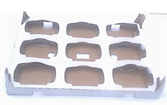
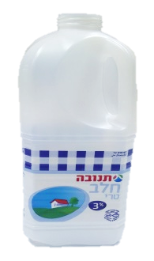
Professional Services
packaging Product design - designed development, functional, ergonomic, efficient and economical, for all types of industries: food, pharmaceuticals, cosmetics, chemicals, etc.
.

Slide 5
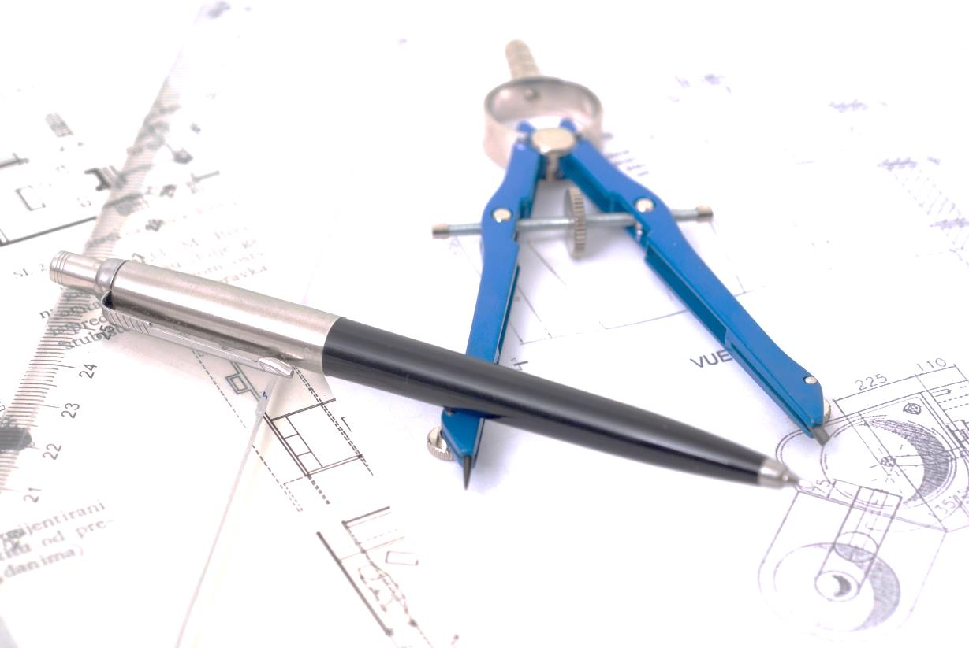
Professional Services
technical specifications Preparation - engineering Design and drawings before preparing a model or mold.
Create 3D models and technical specifications.

Slide 6
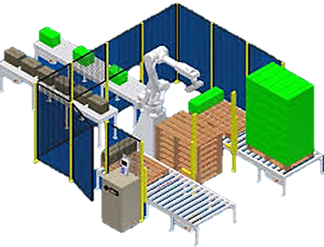
Professional Services
Supply chain processes and production floor packaging -
management of production processes, Selection of suitable suppliers and manufacturers, supervision and ongoing supervision at all stages.
Checking packaging materials, types of materials used by the company
Matching packaging materials relevant to your company's products
Checking the suppliers of the various packaging products
Accompanying the purchasing system with suppliers in terms of materials, pricing, compliance according standards requirements and quality control
Add new suppliers

Slide 7
Quality Control
Quality control of the packaging materials received in the warehouse and the requirements of the technical specifications
Prepared and adapted to the needs of the company.

Slide 8
Transportation, container loading and logistics
Logistic planning for the transportation of goods in an efficient and economical ways:
Adjustment of different types of pallets to the existing means of transport in the factory, in order to save costs.
Reduce baggage weight for export
Reducing the volume of goods
Effective planning of leading / containerization.

Slide 9
The company’s vision
Providing professional and courteous service.
Collaboration for success
Ongoing management of projects from beginning to end.
Innovation, creativity and thinking out-of- box.
Compliance with international standards
Our experience and your success!

Slide 10
Experience and professionalism
Over 30 years experience in various packaging fields and in large and complex projects in a variety of leading companies.
among our clients:

Slide 11
Contact us
.
1, Zadal St. Rishon Le Zion
Tel: + 972-3-5653455
Fax:+972-3-5653456
E-mail: office@adasinterag.com
www.adasinterag.com

